Slide 1

Hotel booking analysis
Explanatory analysis and recommendations

Slide 2
I. Explanatory Data Analysis
1. Cancellation rates
2. Seasonality
3. Pricing
4. Customer insights
5. Market insights

Slide 3
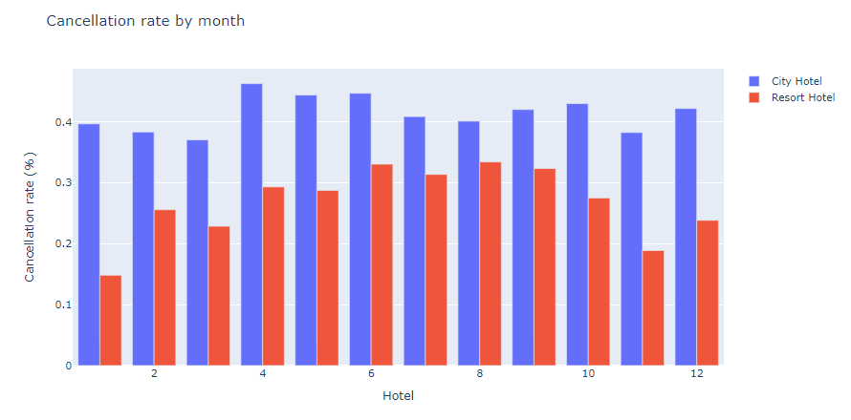
1. Cancellation rates
The overall booking cancellation rate was 37%.
Cancellation rates at City Hotel were significantly higher than at Resort Hotel.

Slide 4
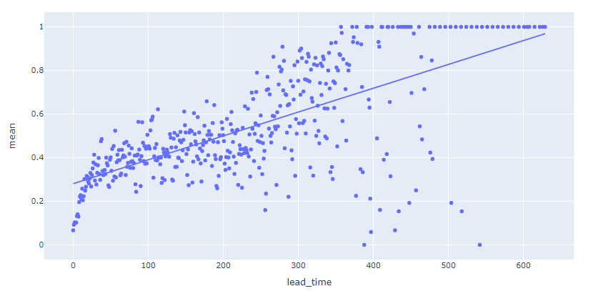
1. Cancellation rates
There is a strong linear correlation between lead time and cancellation rates. Early bookers were more likely to abandon their reservations.

Slide 5
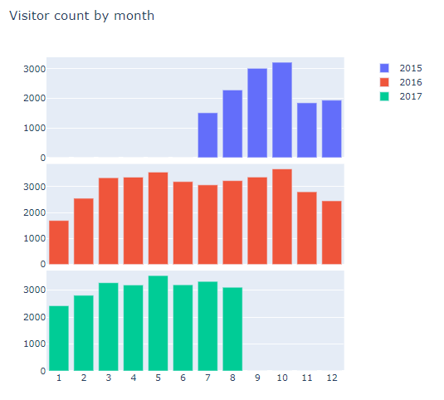
2. Seasonality
The overall peak season was from March to October, while the demand was lowest in December and January.

Slide 6
3. Pricing
- The average price for a room at City Hotel was 105.75EUR per night, while that figure would be 90.79EUR at Resort Hotel.
- On average, a guest paid 59.27EUR for a night at City Hotel or 47.48EUR at Resort Hotel.

Slide 7
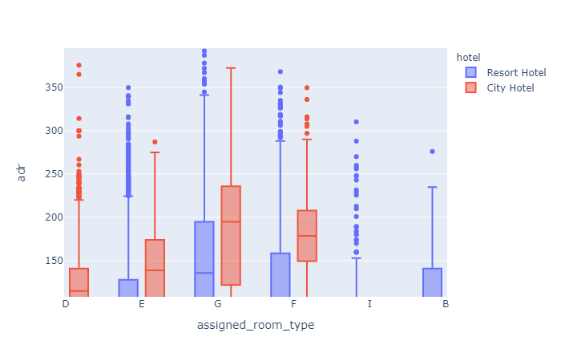
3. Pricing
In general, the cost for staying at City Hotel is higher than Resort Hotel for the same room type.

Slide 8
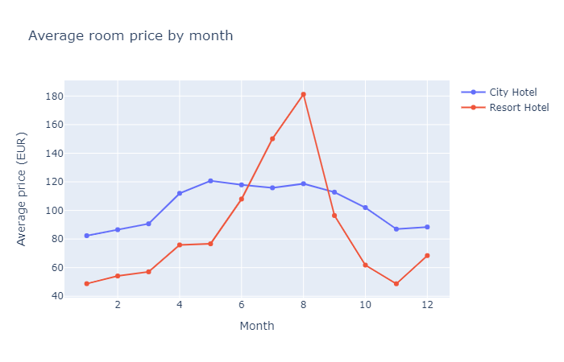
3. Pricing
- The average room price at Resort Hotel peaked in summer (August), while hitting its bottom in January and November.
- The room price at City Hotel on the other hand had a mild fluctuation, with its busy seasons lasting from April to October.

Slide 9
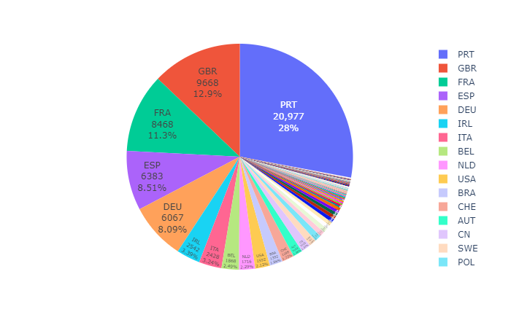
4. Customer insights
Nationality
These hotels mostly welcome local travelers (Portuguese), whilst Britain and France respectively are the 2nd and 3rd most popular countries of visitors.

Slide 10
4. Customer insights
Age group
A typical booking on average has 2 people, with no children or babies.
21.76% of reservations are single adult guests
72.4% of guests come in pairs.
Only 5.4% of guest groups come larger than 2 adults.
Most guests were seldom accompanied by children or babies.

Slide 11
4. Customer insights
Length of stay
An average guest stayed 1 night on weekends, or 2.5 nights during the week.
43.23% did not stay over weekends.
26.1% stayed for 1 weekend night (Saturday or Sunday)
27.7% stayed for both weekend nights.
27.25% stayed for 1 weekday night.
-25% stayed for 2 weekday nights.

Slide 12
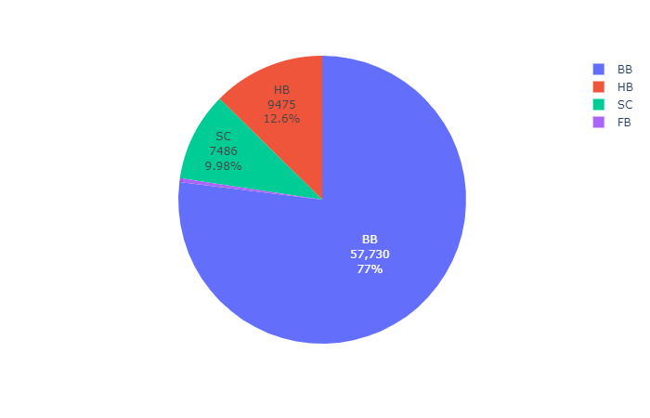
4. Customer insights
Meal preferences
76.9% preferred bed and breakfast (BB) option.
12.6% favored half board (HB) choice (Breakfast and Dinner),
10% chose self-catering (SC).
About 0.4% selected full board (FB) meal (Breakfast, Lunch and Dinner).
10% favored self-catering (SC).

Slide 13
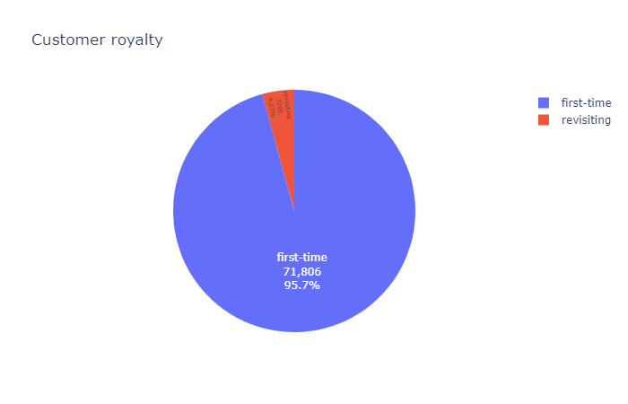
4. Customer insights
Customer loyalty
The majority of bookings are new guests (95.7%).
Only 4.3% revisited.

Slide 14
4. Customer insights
Car park spaces
- About 90% of customers did not need car parking lots
- 10% asked for car parking spots.

Slide 15
4. Customer insights
Special requests
- The majority of customers did not have special requests (48.9%)
- 34% guests had 1 special request.
- about 16% guests had 2 or more special requests.

Slide 16
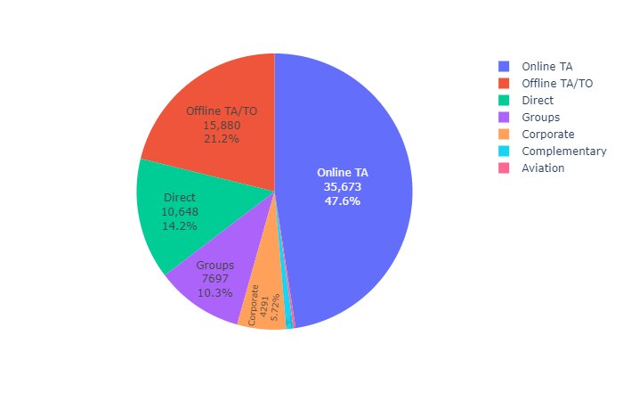
5. Market insights
Customer journey
- The 2 hotels mostly sold rooms via travel agencies (TA) and tour operators (TO). These are the main sources of customer bookings, with online travel agencies (TA) responsible for 47.5% of reservations and the other 21.1% coming from offline channels.
- About 14% guests booked directly with the hotels.
- 10% customers booked in groups.

Slide 17
5. Market insights
Deposit type
- Nearly all bookings did not require deposits.

Slide 18
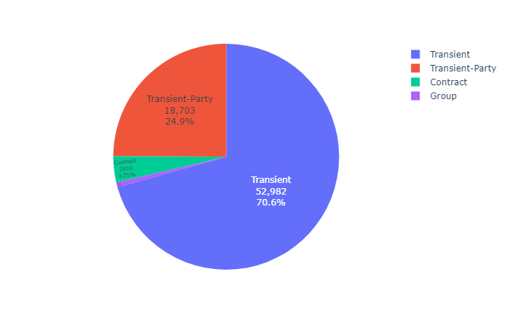
5. Market insights
Customer type
- The majority of guests were short-term individual travelers (95%).
- Guests staying on long-term contracts only occupied a humble percentage (3.75%), such as contracts with aviation companies.

Slide 19
II. Recommendations
Reduce cancellation rates
Reinforce customer royalty
Increase restaurant revenues

Slide 20
II. Recommendations
1. Reduce cancellation rates
Require a small cancellation fee.
Offer a reward for early bookers that arrive.
Customer care (phone/emails) prior and after their stays.
Predict cancellation using Machine Learning algorithms.

Slide 21
II. Recommendations
2. Reinforce customer royalty
Follow-up with customers to collect feedbacks for quality control.
Develop loyalty/membership program
Focus on experience and quality excellence delivery

Slide 22
II. Recommendations
3. Increase restaurant revenues
Half-board and full-board meals can be a potential market to cross-sell products and services to gain more profits from food and beverages.
Adjust menus to include cheaper and more affordable options.
Organize small fun events such as drinking hours with an acceptable discounts
Offer 'Deal of the day’ which features discounted local dishes to attract customers.

